Slide 1

Single-Cycle RISC-V CPU (RV32I) Design & Simulation
Presenter - 석경현

Slide 2
INDEX
Overview
CPU Architecture (RV32I)
Dataflow / Simulation
Trouble Shooting
Conclusion

Slide 3
Overview
Project Purpose
Design and Implementation of a single-cycle CPU based on
RISC-V architecture (Harvard, RV32I)
Verification of basic instruction set operation and
understanding of hardware operation
Environment
C, SystemVerilog, Vivado, RISC-V Assembler

Slide 4
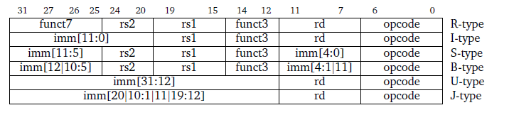
RV32I Instruction
RV32I
32-bit Integer basic instruction set
Characteristics
32 general purpose registers (32-bit each, zero register)
Use 32-bit address (Up to 4GB)
R, I, S, B, U, J Types (32-bit instructions)
Simple and intuitive without complex commands

Slide 5
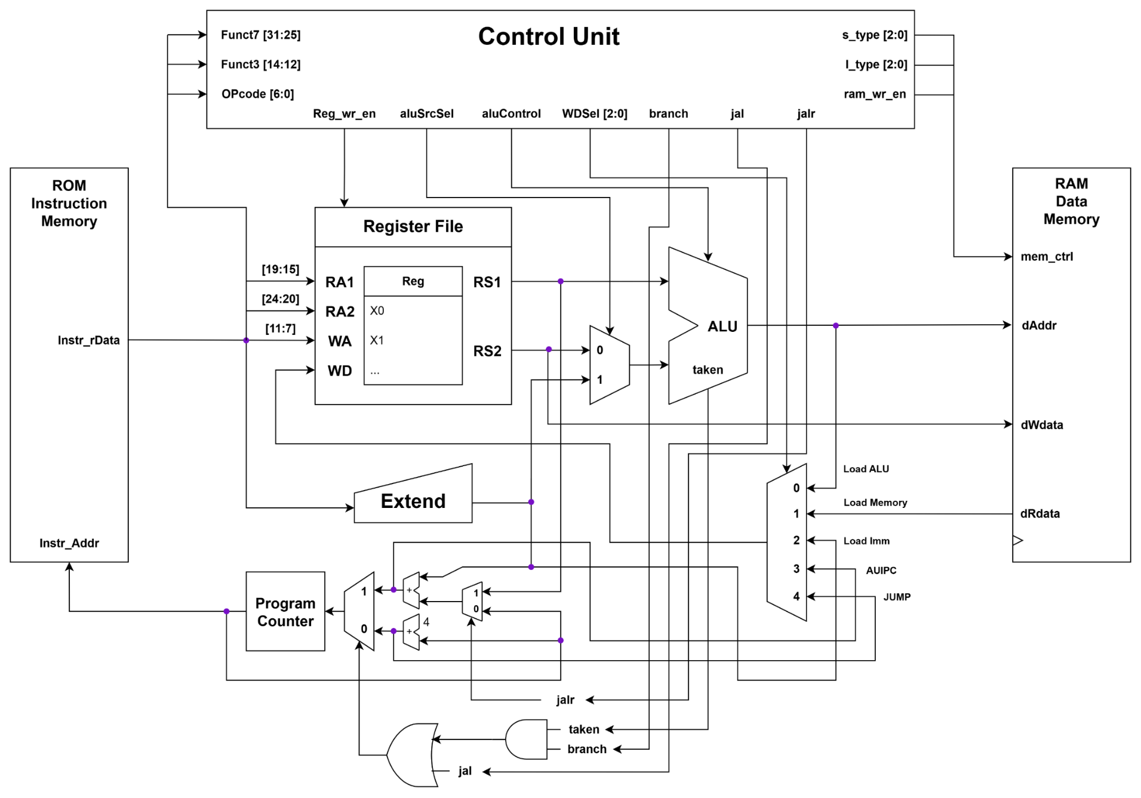
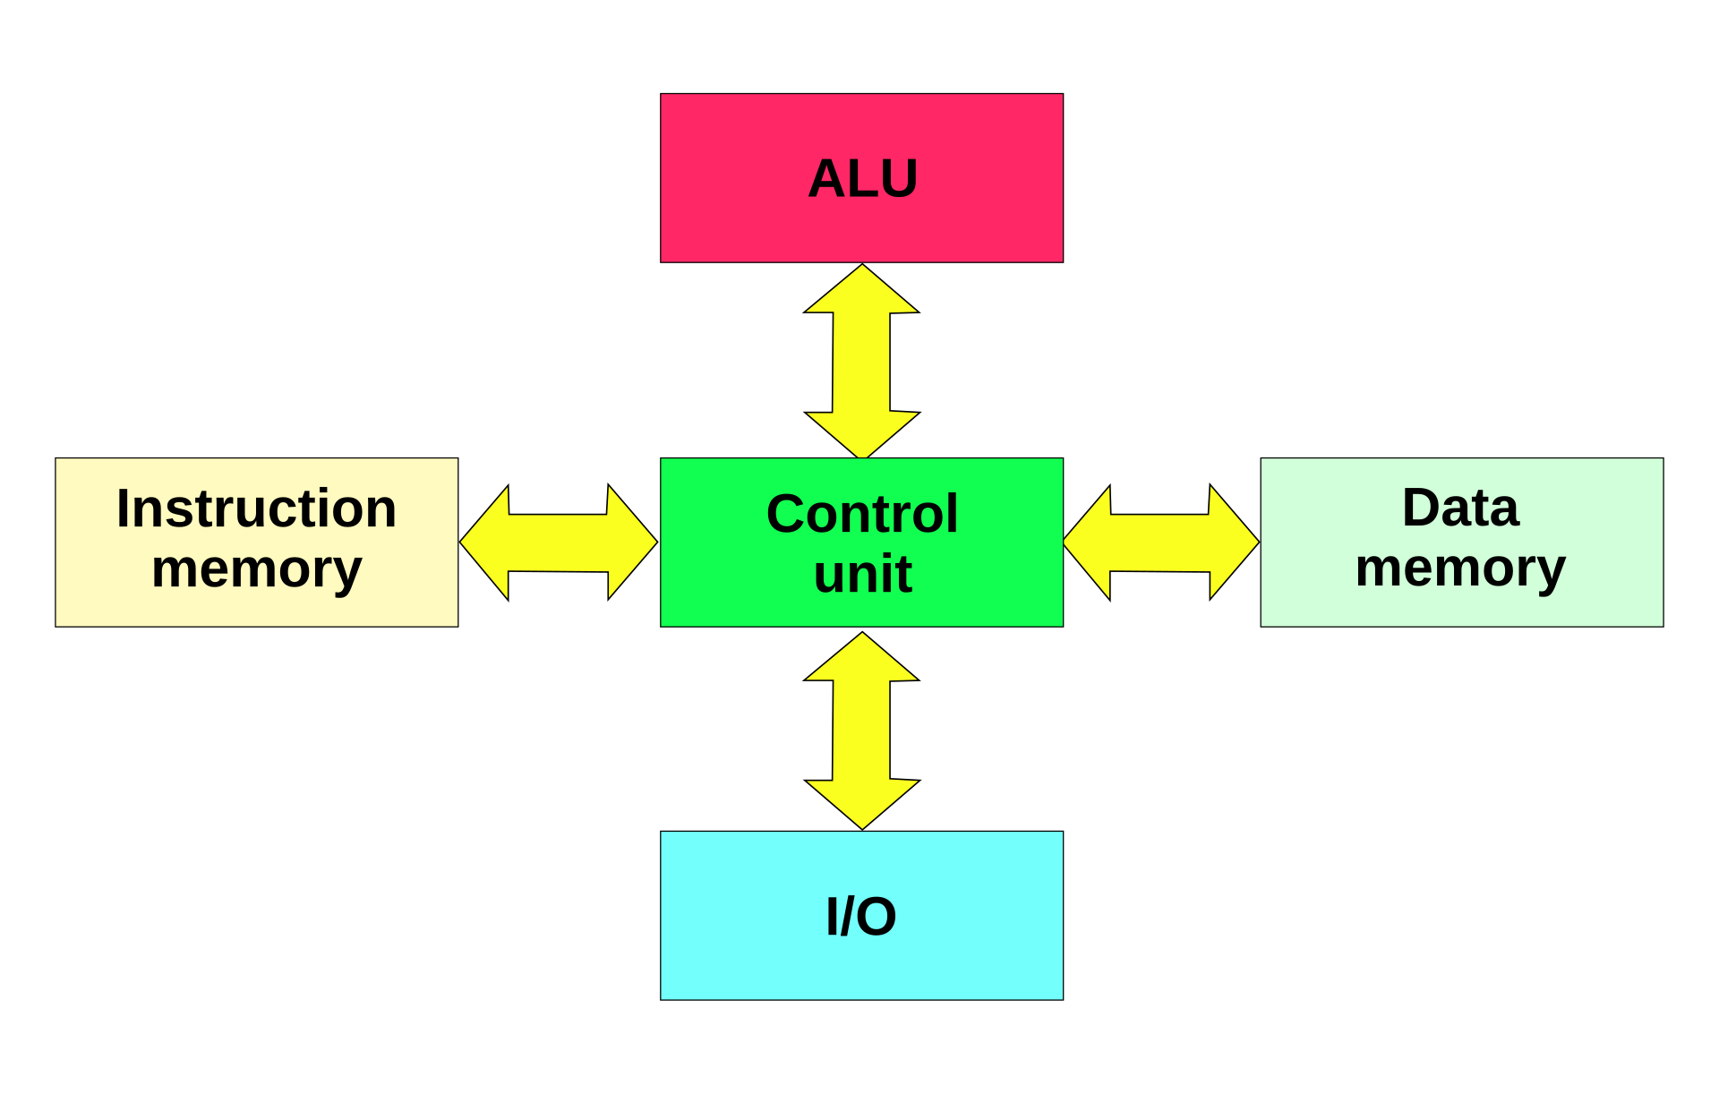
CPU Architecture (RV32I)
Harvard Architecture
Instruction memory and data memory are separated
Parallel access possible → Speed↑

Slide 6
How CPU works
Instruction Fetch (IF)
→ Read instructions from memory using PC(Program Counter) value
Instruction Decode (ID)
→ Interpret the instruction and decide what operation it is and which register to use
Execute (EX)
→ ALU performs operations (add, sub, address calculation, comparison, etc.)
Memory Access (MEM)
→ Access memory with load/store command (read/write)
Write Back (WB)
→ Save operation results or values read from memory in the register

Slide 7
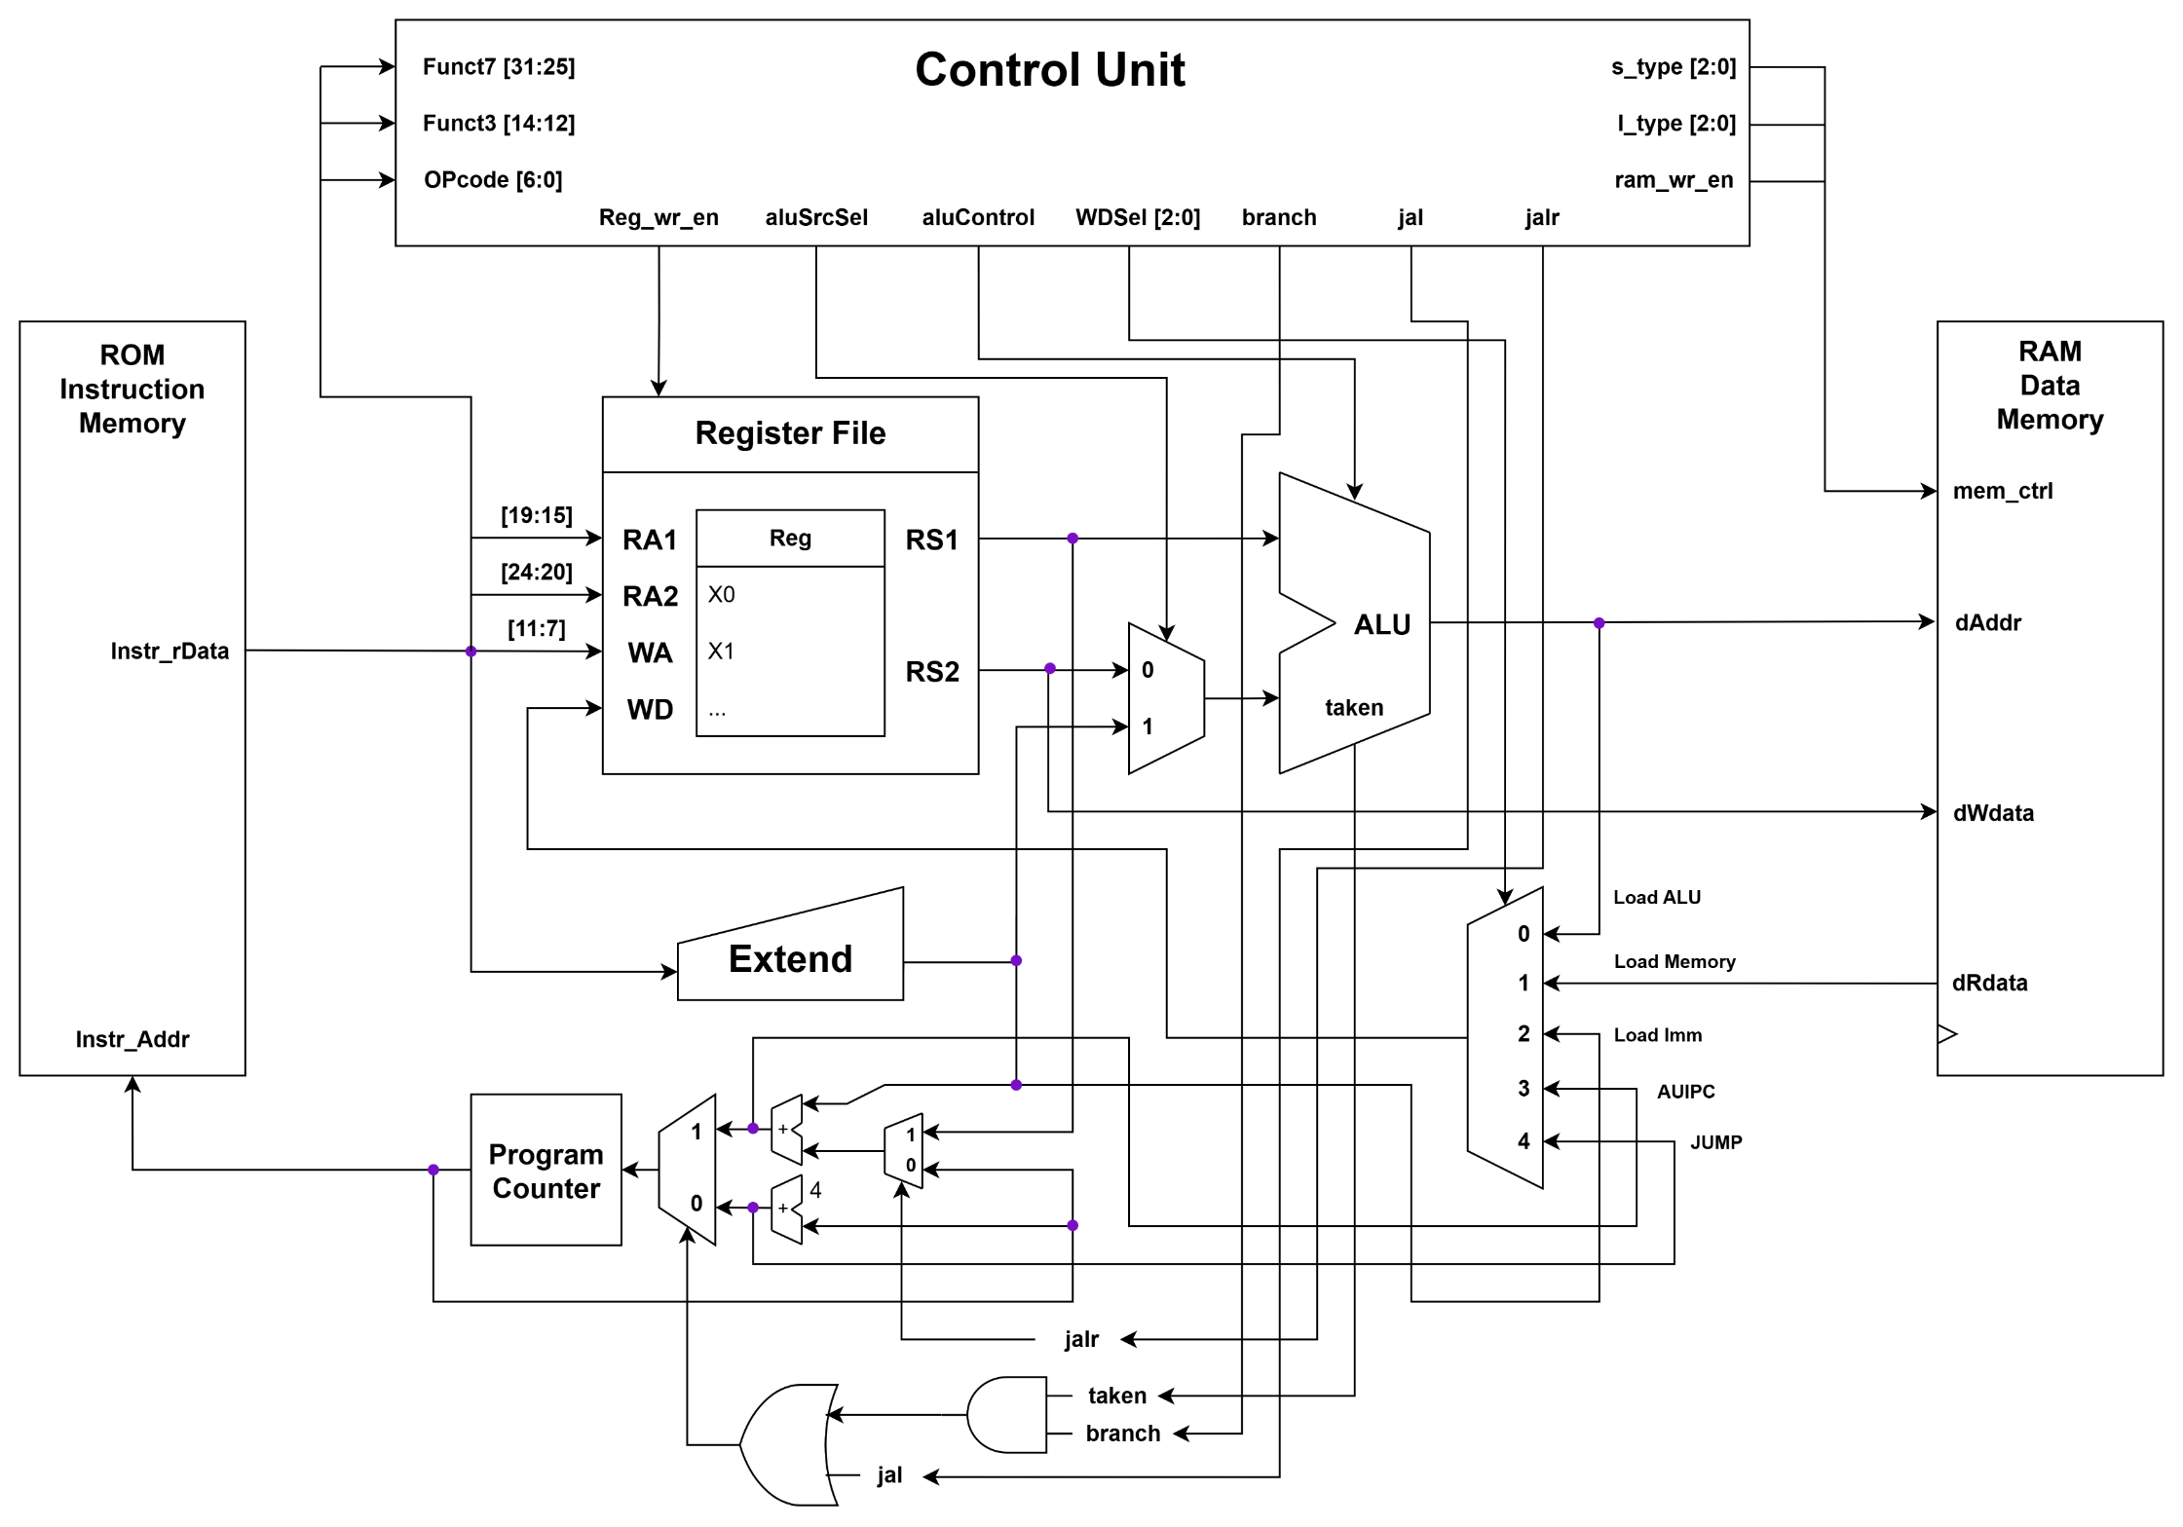





R-Type Dataflow
ADD | rd = rs1 + rs2
SUB | rd = rs1 - rs2
SLL | rd = rs1 << rs2
SRL | rd = rs1 >> rs2
SRA | rd = rs1 >>> rs2 | msb-extends
SLT | rd = (rs1 < rs2)?1:0
SLTU | rd = (rs1 < rs2)?1:0 | zero-extends
XOR | rd = rs1 ^ rs2
OR | rd = rs1 | rs2
AND | rd = rs1 & rs2
ID
IF
EX
Register & Register Operations
WB
< IF – ID – EX – WB >
Control Unit Output
Reg_wr_en = 1
aluControl = funct3
WD_sel[2:0] = 0

Slide 8
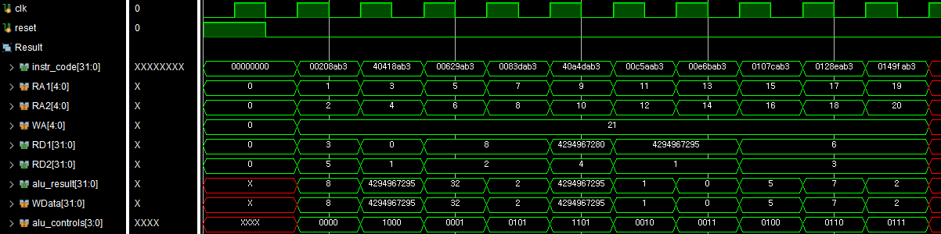
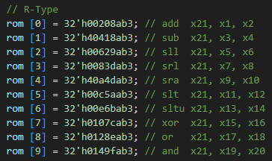
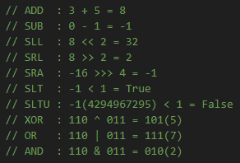
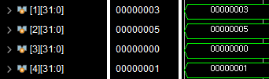
R-Type Simulation
addr
value
result
ADD
SUB
SLL
SRL
SRA
SLT
SLTU
XOR
OR
AND
PASSED !!

Slide 9







S-Type Dataflow
ID
S | SB | M[rs1+imm][0:7] = rs2[0:7]
S | SH | M[rs1+imm][0:15] = rs2[0:15]
S | SW | M[rs1+imm][0:31] = rs2[0:31]
Store register values in memory
IF
EX
< IF – ID – EX – MEM >
MEM
Control Unit Output
aluSrcSel = 1
aluControl = ADD
Store_type[2:0] = funct3
Ram_wr_en = 1

Slide 10
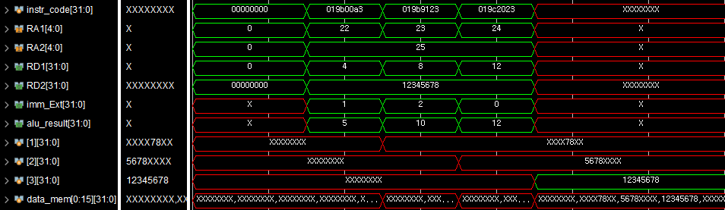

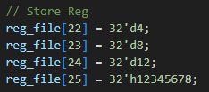
S-Type Simulation
SB
SH
SW
Store Byte(12345678) : addr = rs1(4) + imm(1) = 5
Result = xxxx78xx
Store Half(12345678) : addr = rs1(8) + imm(2) = 10
Result = 5678xxxx
Store Word(12345678) : addr = rs1(12) + imm(0) = 12
Result = 12345678
PASSED !!

Slide 11



I-Type(Load) Dataflow
ID
I | LB | rd = M[rs1+imm][0:7]
I | LH | rd = M[rs1+imm][0:15]
I | LW | rd = M[rs1+imm][0:31]
I | LBU | rd = M[rs1+imm][0:7] | zero-extends
I | LHU | rd = M[rs1+imm][0:15] | zero-extends
EX
Load values in memory
IF
MEM
< IF – ID – EX – MEM – WB >
Control Unit Output
Reg_wr_en = 1
aluSrcSel = 1
aluControl = ADD
WD_sel[2:0] = 1
Load_type[2:0] = funct3
WB

Slide 12
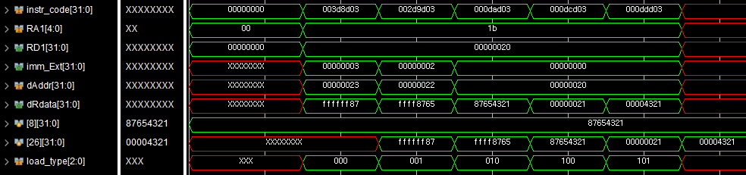
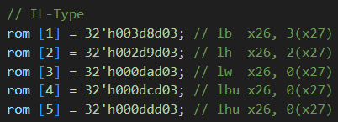

I-Type(Load) Simulation
LB
LH
LW
LBU
LHU
LB(87654321) : ffffff87 (sign-ext)
LH(87654321) : ffff8765 (sign-ext)
LW(87654321) : 87654321
LBU(87654321) : 00000021 (zero-ext)
LHU(87654321) : 00004321 (zero-ext)
PASSED !!

Slide 13



I-Type(Imm) Dataflow
I | ADDI | rd = rs1 + imm
I | SLTI | rd = (rs1 < imm)?1:0
I | SLTIU | rd = (rs1 < imm)?1:0 | zero-extends
I | XORI | rd = rs1 ˆ imm
I | ORI | rd = rs1 | imm
I | ANDI | rd = rs1 & imm
I | SLLI | rd = rs1 << imm[0:4]
I | SRLI | rd = rs1 >> imm[0:4]
I | SRAI | rd = rs1 >>> imm[0:4] | msb-extends
ID
IF
EX
Register & imm operations
WB
< IF – ID – EX – WB >
Control Unit Output
Reg_wr_en = 1
aluSrcSel = 1
aluControl = funct3
WD_sel[2:0] = 0

Slide 14
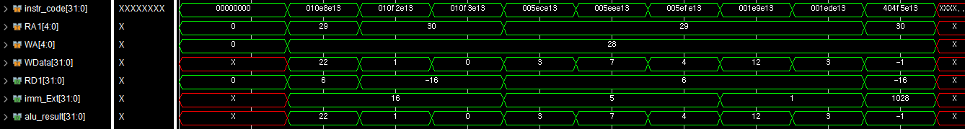
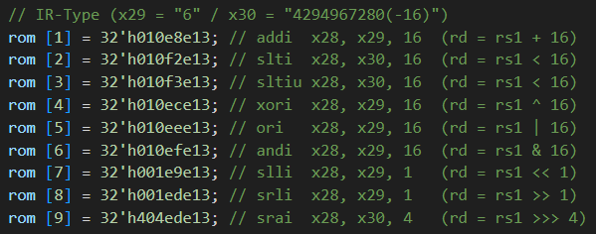
I-Type(Imm) Simulation
ADDI
SLTI
SLTIU
XORI
ORI
ANDI
SLLI
SRLI
SRAI
ADDI : 6 + 16 = 22
SLTI : -16 < 16 = 1(True)
SLTIU : -16 < 16 = 0(False)
XORI : 110 ^ 101 = 011 (3)
ORI : 110 | 101 = 111 (7)
ANDI : 110 & 101 = 100 (4)
SLLI : 110 << 1 = 1100 (12)
SRLI : 110 >> 1 = 11 (3)
SRAI : -16 >>> 4 = -1
PASSED !!

Slide 15




B-Type Dataflow
ID
B | BEQ | if(rs1 == rs2) PC += imm
B | BNE | if(rs1 != rs2) PC += imm
B | BLT | if(rs1 < rs2) PC += imm
B | BGE | if(rs1 >= rs2) PC += imm
B | BLTU | if(rs1 < rs2) PC += imm | zero-extends
B | BGEU | if(rs1 >= rs2) PC += imm | zero-extends
IF
EX
Branch Function
Conditional jump
< IF – ID – EX >
Control Unit Output
aluControl = funct3
Branch = 1

Slide 16
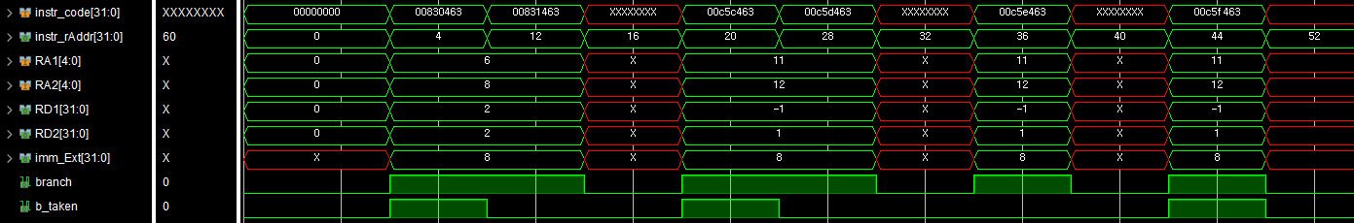
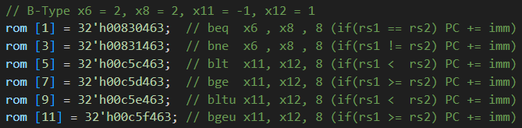
B-Type Simulation
BEQ
BNE
BLT
BGE
BLTU
BGEU
BEQ : 2 == 2 → PC += 8 (12)
BNE : 2 != 2 → False
BLT : -1 < 1 → PC += 8 (28)
BGE : -1 >= 1 → False
BLTU : -1 < 1 → False
BGEU : -1 >= 1 → PC += 8 (52)
PASSED !!

Slide 17

U-Type Dataflow (LUI)
ID
LUI | rd = imm << 12
AUIPC | rd = PC + (imm << 12)
MSB 20-bit imm value processing
IF
To make large imm in the register
< IF – ID – EX – WB >
WB
Control Unit Output
Reg_wr_en = 1
WD_sel[2:0] = 2
EX

Slide 18


U-Type Dataflow (AUIPC)
ID
LUI | rd = imm << 12
AUIPC | rd = PC + (imm << 12)
MSB 20-bit imm value processing
IF
PC-relative addressing
< IF – ID – EX – WB >
WB
Control Unit Output
Reg_wr_en = 1
WD_sel[2:0] = 3
EX

Slide 19
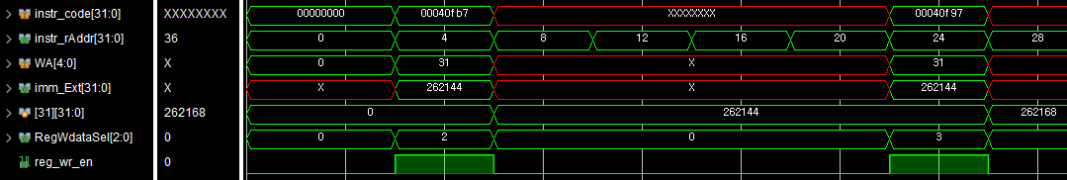

U-Type Simulation
LUI
AUIPC
LUI : rd = 64 << 12 = 262144
AUIPC : rd = 24 + (64 << 12) = 262168
PASSED !!

Slide 20

J-Type Dataflow (JAL)
ID
J | JAL | rd = PC+4; PC += imm
I | JALR | rd = PC+4; PC = rs1 + imm
IF
Unconditional jump + store return values
Static Function call
< IF – ID – EX – WB >
WB
Control Unit Output
Reg_wr_en = 1
WD_sel[2:0] = 4
Jal = 1
EX

Slide 21


I(J)-Type Dataflow (JALR)
ID
J | JAL | rd = PC+4; PC += imm
I | JALR | rd = PC+4; PC = rs1 + imm
IF
Unconditional jump + store return values
Return & Dynamic function call
< IF – ID – EX – WB >
WB
Control Unit Output
Reg_wr_en = 1
WD_sel[2:0] = 4
Jal = 1
Jalr = 1
EX

Slide 22
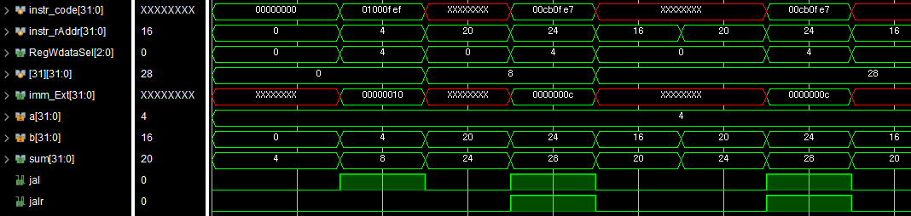

J-Type Simulation
JAL
JALR
JALR
JAL : rd = PC + 4, PC += 16
JALR : rd = PC + 4, PC = (4 + 12)
PASSED !!

Slide 23
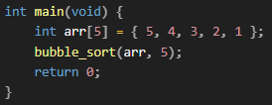
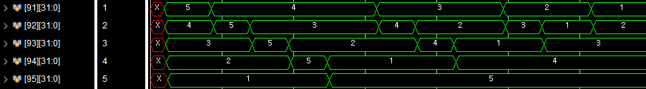
Code Execution
# temp = *a
lw a5,-36(s0) # load addr of a
lw a5,0(a5) # load *a value
sw a5,-20(s0) # temp = *a
# *a = *b
lw a5,-40(s0) # load addr of b
lw a4,0(a5) # load *b value
lw a5,-36(s0) # load addr of a
sw a4,0(a5) # *a = *b
# *b = temp
lw a5,-40(s0) # load addr of b
lw a4,-20(s0) # load temp
sw a4,0(a5) # *b = temp
jr ra # exit swap function
Bubble Sort(Ascending)
{ 5, 4, 3, 2 ,1 } → Sorting → { 1, 2, 3, 4, 5 }

Slide 24
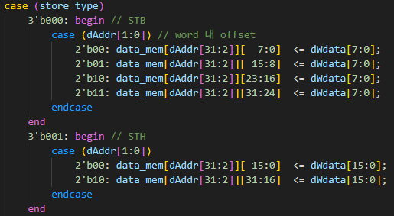
Trouble Shooting
Memory Alignment
There was confusion about how memory was aligned when
storing or loading data into RAM
Byte, Half Data Store / Load Option
It’s important to handle the offset [1:0] of the address
Solved by using case statement (MUX)
Misalignment should be ignored in RISC-V
0x00001234 (O) / 0x00012340 (X)

Slide 25













Trouble Shooting
Clock Timing Analysis
Critical Path = ”Load instruction”
Inefficient Clock Usage
T_clk ≥ t_PC + t_ROM + t_CU + t_REG(rd) +
t_ALU + t_RAM + t_MUX + t_REG(wr) +
t_skew + ...
The Limitation of single-cycle CPU
So, it should operate with T_clk even in the datapath with shorter delays

Slide 26
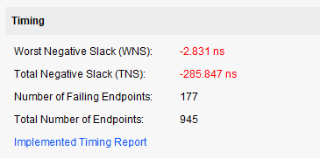
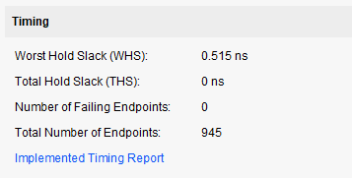
Trouble Shooting
Timing Report
System Clock(10ns) < Load instruction(13ns)

Slide 27
Conclusion
Key takeaways
Helps in understanding basic CPU operation flow
Simple but inefficient ...
Improvements
Scaling to multi-cycle and pipeline for improved performance
Verification for a wider range of cases using UVM

Slide 28
Thanks for listening

